Slide 1
Chapter 3:
Classification
Oguzhan Uyar

Slide 2
Index
1
Introduction
MNIST-Dataset
Binary Classifier
Performance Measures
Confusion Matrix
Precision/Recall Tradeoff
ROC Curve
Multiclass Classification
Error Analysis
Multilabel Classification
Multioutput Classification

Slide 3
Intoduction
2

Slide 4
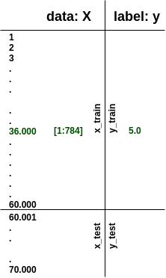
2- MNIST-Dataset
3
Considered as the “Hello World”-set of ML
A set of handwritten digits [0-9], 70.000 records
Has two columns: data, label
data key: array with 1 row per instance (w/ 784 features)
1 col per feature
target key: an array with the labels
Data already split into training and test sets
>>> X, y = mnist["data"], mnist["target"]
>>> X.shape
(70000, 784)
>>> y.shape
(70000,)
>>> X_train, X_test, y_train, y_test = X[:60000], X[60000:], y[:60000], y[60000:]

Slide 5

3- Binary Classifier
4
Classifies into two classes
for our case: 5s & non-5s
Stochastic Gradient Descent Classifier (SGDClassifier()) good starting point with large datasets
Many more classifiers: RandomForest, KNeighbors,..
>>> sgd_clf = SGDClassifier(random_state=42)
>>> sgd_clf.fit(X_train, y_train_5)
>>> sgd_clf.predict([some_digit]) # some_digit = 5
array([True], dtype=bool)
Notes:
Returns a simple boolean prediction.
sgd_clf = SGDClassifier(random_state=42)
sgd_clf.fit(X_train, y_train_5)
>>> sgd_clf.predict([some_digit])
array([ True], dtype=bool)

Slide 6
4- Performance Measures
5
Many ways of performance measures
Really good way: cross-validation
This time: accuracy!
>>> sgd_clf = SGDClassifier(random_state=42)
>>> cross_val_score(sgd_clf, X_train, y_train_5, cv=3, scoring=”accuracy”)
array([ 0.9502 , 0.96565, 0.96495])
WOW! 95% accuracy.
Notes:
Accuracy: ratio of correct predictions

Slide 7
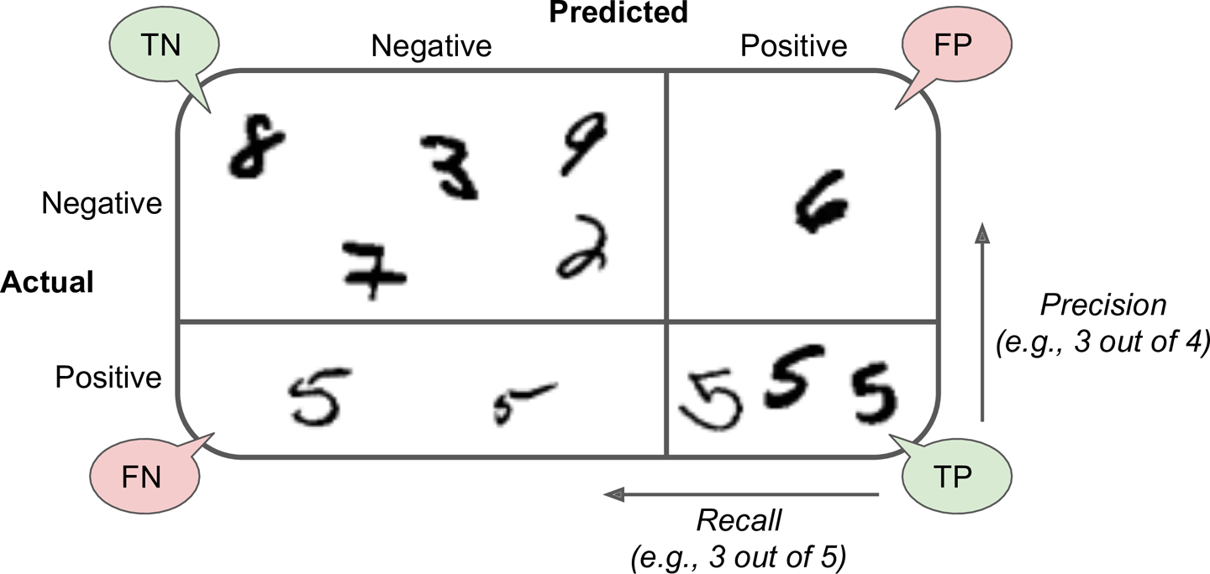
4a- Confusion Matrix
6
Notes:
Returns a simple boolean prediction.
sgd_clf = SGDClassifier(random_state=42)
sgd_clf.fit(X_train, y_train_5)
>>> sgd_clf.predict([some_digit])
array([ True], dtype=bool)

Slide 8
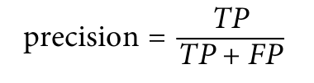

4a- Confusion Matrix
7
>>> sgd_clf = SGDClassifier(random_state=42)
>>> y_train_pred = cross_val_predict(sgd_clf, X_train, y_train_5, cv=3)
>>> confusion_matrix(y_train_5, y_train_pred)
array([[53272, 1307],
[ 1077, 4344]])
>>> precision_score(y_train_5,y_train_pred)
0.76871350203503808
>>> recall_score(y_train_5,y_train_pred)
0.80132816823464303
Notes:
Returns a simple boolean prediction.
sgd_clf = SGDClassifier(random_state=42)
sgd_clf.fit(X_train, y_train_5)
>>> sgd_clf.predict([some_digit])
array([ True], dtype=bool)

Slide 9
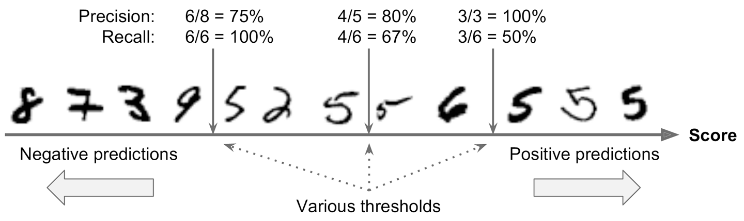
4b- Precision/Recall Tradeoff
8
Precision/Recall score changes with the given thresholds
Raising the threshold decreases recall
Notes:
Returns a simple boolean prediction.
sgd_clf = SGDClassifier(random_state=42)
sgd_clf.fit(X_train, y_train_5)
>>> sgd_clf.predict([some_digit])
array([ True], dtype=bool)

Slide 10
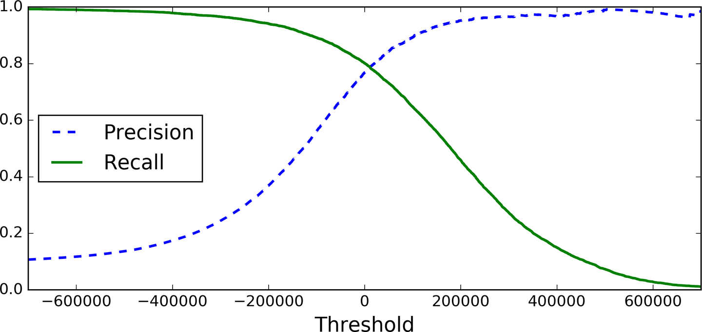
4b- Precision/Recall Tradeoff
9
Plotting can help finding the right threshold
You can simply select the best value for the precision/recall tradeoff
Notes:
Returns a simple boolean prediction.
sgd_clf = SGDClassifier(random_state=42)
sgd_clf.fit(X_train, y_train_5)
>>> sgd_clf.predict([some_digit])
array([ True], dtype=bool)

Slide 11
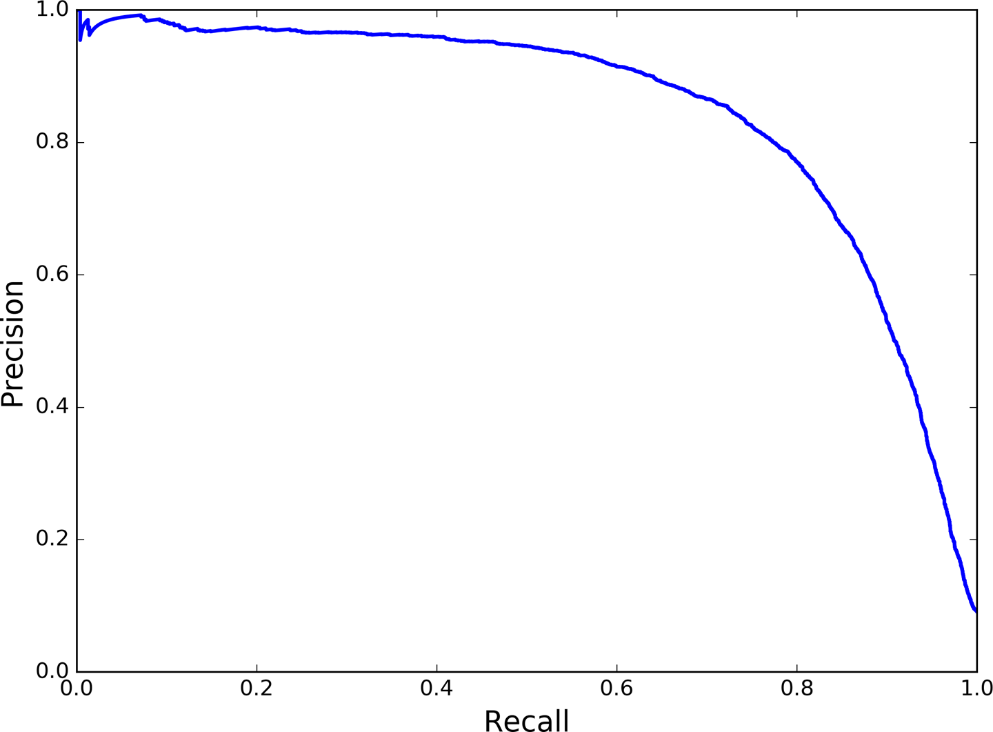
4b- Precision/Recall Tradeoff
10
Additionally plot precision against recall
Shows that precision falls sharply about 80% recall
Notes:
Returns a simple boolean prediction.
sgd_clf = SGDClassifier(random_state=42)
sgd_clf.fit(X_train, y_train_5)
>>> sgd_clf.predict([some_digit])
array([ True], dtype=bool)

Slide 12
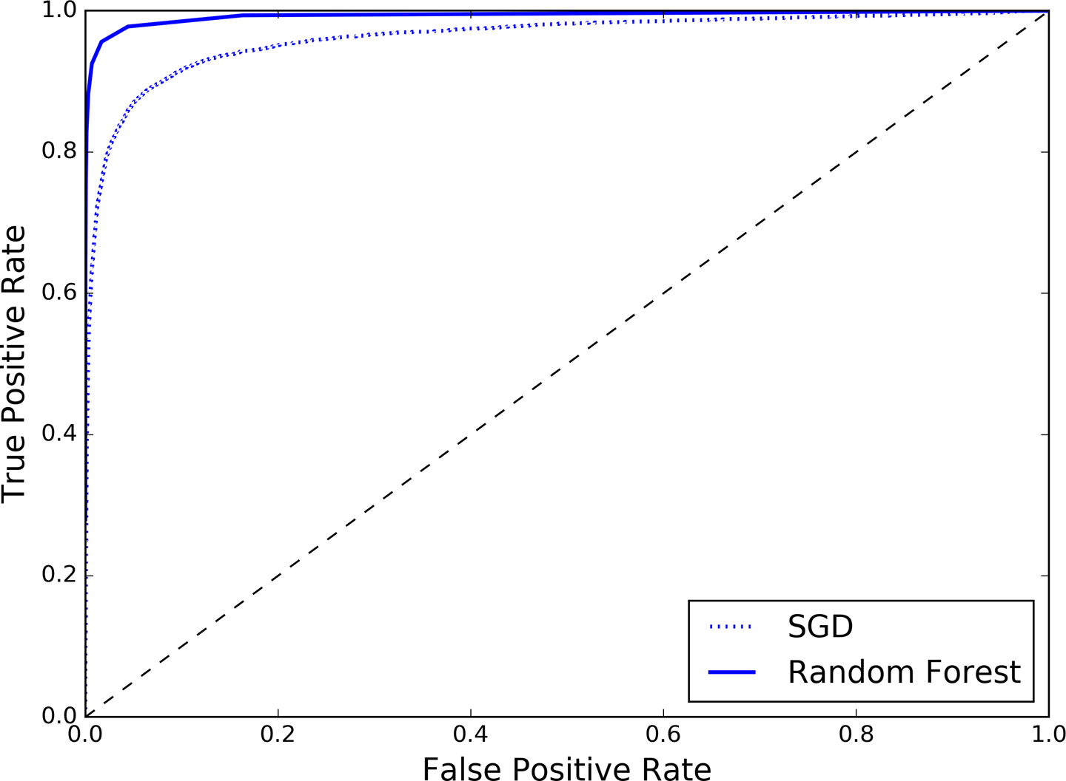



4c- ROC Curve
11
Plots recall (TPR) vs 1 - specifity (FPR)
once again tradeoff: high recall (TPR) = more false positives (FPR)
comparing classifiers: Area Under Curve (AUC)
Notes:
Returns a simple boolean prediction.
sgd_clf = SGDClassifier(random_state=42)
sgd_clf.fit(X_train, y_train_5)
>>> sgd_clf.predict([some_digit])
array([ True], dtype=bool)

Slide 13
5- Multiclass Classification
12
Classifies into n-classes
our case: 0-9 classes
Some classifiers directly capable of multiclass (Random Forest or naive Bayes),
others strictly binary (Support Vector Machine or Linear)
Still possible to use binary for multiclass
e.g. train 10 classifiers for each class and compare the scores for given instance
this is called: one-versus-all (OvA) (also called one-versus-rest)
another way: train classifier for every pair of digits (0vs1,0vs2,2vs1..)
this is call: one-versus-one (OvO)
for N classes, you need to train N x (N - 1) / 2 = 45 (our case)
main advantage: every classifier gotta train only a part of whole set
>>> sgd_clf = SGDClassifier(random_state=42)
>>> sgd_clf.fit(X_train, y_train) # y_train, not y_train_5 # OvA example
>>> sgd_clf.predict([some_digit]) # some_digit = 5
array([5])
Notes:
Returns a simple boolean prediction.
sgd_clf = SGDClassifier(random_state=42)
sgd_clf.fit(X_train, y_train_5)
>>> sgd_clf.predict([some_digit])
array([ True], dtype=bool)

Slide 14
5- Multiclass Classification
13
>>> sgd_clf = SGDClassifier(random_state=42)
>>> sgd_clf.fit(X_train, y_train) # y_train, not y_train_5
>>> sgd_clf.predict([some_digit]) # some_digit = 5
array([5,])
>>> some_digit_scores = sgd_clf.decision_function([some_digit])
yields an array len: 10, with a score for each class
>>> ovo_clf = OneVsOneClassifier(SGDClassifier(random_state=42))
>>> ovo_clf.fit(X_train, y_train) # y_train, not y_train_5
>>> ovo_clf.predict([some_digit]) # some_digit = 5
array([5.])
>>> len(ovo_clf.estimators_)
45
>>> forest_clf = RandomForestClassifier(random_state=42)
>>> forest_clf.fit(X_train, y_train) # y_train, not y_train_5
>>> forest_clf.predict([some_digit]) # some_digit = 5
array([5.])
>>> forest_clf.predict_proba([some_digit]) # some_digit = 5
array([[ 0.1, 0. , 0. , 0.1, 0. , 0.8, 0. , 0. , 0. , 0. ]])
Notes:
Returns a simple boolean prediction.
sgd_clf = SGDClassifier(random_state=42)
sgd_clf.fit(X_train, y_train_5)
>>> sgd_clf.predict([some_digit])
array([ True], dtype=bool)

Slide 15
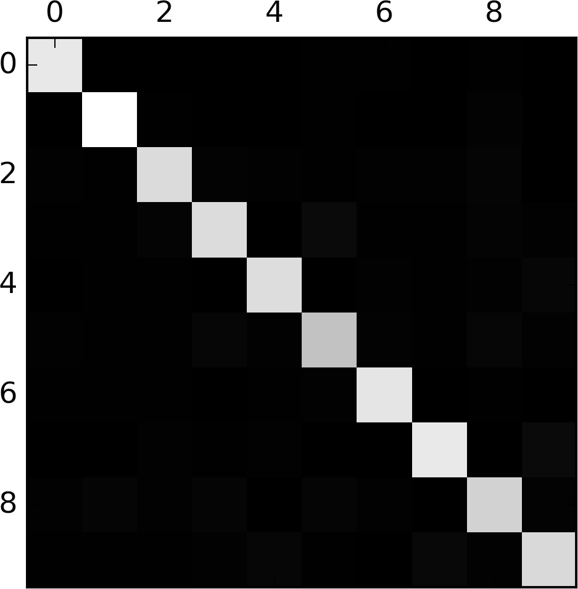
6- Error Analysis
14
First, have a look at the confusion matrix. For binary = 2x2
For multiclass = nxn (our case: 10x10)
Big confusion matrices get confusing, plot them!
Looks fairly good! Most images are on the main diagonal!
The 5 looks slighty darker than the others, let’s have
a look!
Notes:
Returns a simple boolean prediction.
sgd_clf = SGDClassifier(random_state=42)
sgd_clf.fit(X_train, y_train_5)
>>> sgd_clf.predict([some_digit])
array([ True], dtype=bool)

Slide 16
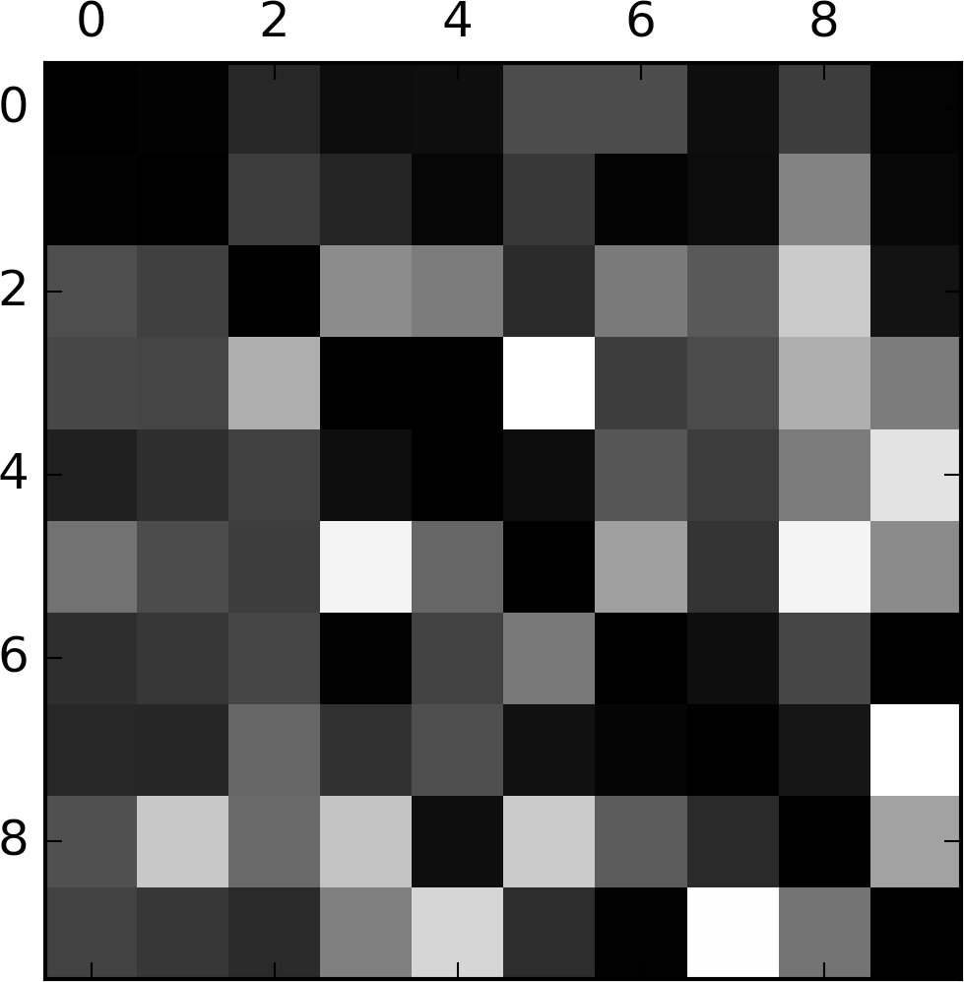
6- Error Analysis
15
Let’s focus on the errors!
divide each value of the confusion matrix by the number of images in the corresponding class!
Then fill the diagonal with zeros to keep only errors!
Looks like classes 8 & 9 have many misclassified instances
Analyzing confusion matrix gives you insights on ways to
improve code!
Notes:
Returns a simple boolean prediction.
sgd_clf = SGDClassifier(random_state=42)
sgd_clf.fit(X_train, y_train_5)
>>> sgd_clf.predict([some_digit])
array([ True], dtype=bool)

Slide 17
7- Multilabel Classification
16
Very briefly!
In some cases you want an instance assigned to more than one class! (e.g. face recognition)
One label (class) per Person classified; for each instance
Classifier: e.g. KNeighborsClassifier()
>>> y_train_large = (y_train >= 7)
>>> y_train_odd = (y_train % 2 == 1)
>>> y_multilabel= np.c_[y_train_large, y_train_odd]
>>> knn_clf = .KNeighborsClassifier(X_train, y_multilabel)
>>> forest_clf.fit(X_train, y_train)
>>> knn_clf.predict([some_digit])
array([[False, True]], dtype=bool)
Notes:
Returns a simple boolean prediction.
sgd_clf = SGDClassifier(random_state=42)
sgd_clf.fit(X_train, y_train_5)
>>> sgd_clf.predict([some_digit])
array([ True], dtype=bool)

Slide 18
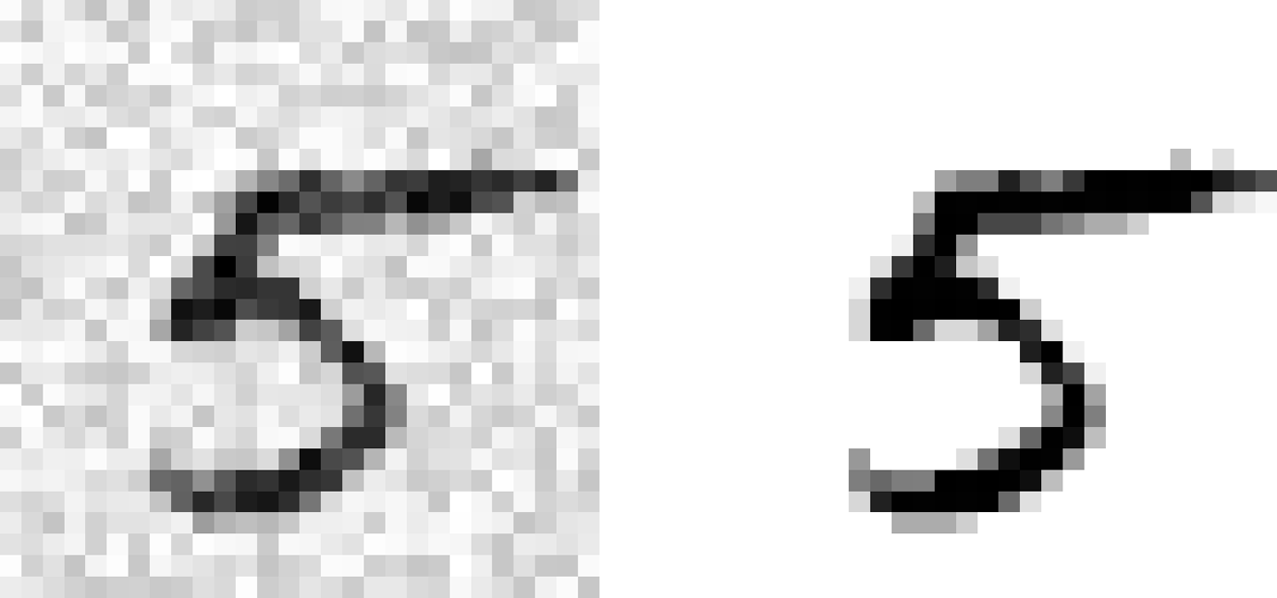
7- Multioutput Classification
17
Simply a generalization of multilabel classification
each label can be multiclass
To illustrate this, we put some noise to the instances and try to clean them
Classifiers output is multilabel: one label per pixel, each can have multiple values
Classifier: KNeighborsClassifier()
Notes:
Returns a simple boolean prediction.
sgd_clf = SGDClassifier(random_state=42)
sgd_clf.fit(X_train, y_train_5)
>>> sgd_clf.predict([some_digit])
array([ True], dtype=bool)

Slide 19
?

Slide 20
Sources
Hands-On Machine Learning with Scikit-Learn and Machine Learning Chapter 3
http://scikit-learn.org/stable/tutorial/machine_learning_map/index.html

